Slide 1



IBM Mission and Vision
As a global technology leader, IBM's mission is to drive innovation and progress through advanced information technology solutions. With a rich history spanning over a century, IBM is committed to shaping the future of business and society through its pioneering products, services, and research initiatives.
by A H

Slide 2

About IBM
1
Established in 1911
2
Global Presence
IBM has a long and storied history as one of the original technology giants, founded over a century ago and evolving alongside the rapid advancements in the industry.
With operations in over 175 countries, IBM has a truly international reach, serving customers across diverse industries and geographies.
3
Diverse Portfolio
From enterprise software and cloud computing to quantum computing and AI, IBM offers a wide range of innovative products and services to meet the ever-changing needs of its clients.

Slide 3
Mission Statement
Driving Innovation
Empowering Businesses
Transforming Industries
IBM's mission is to lead in the invention, development, and manufacture of the industry's most advanced information technologies, including computer systems, software, storage systems, and microelectronics.
By providing cutting-edge IT solutions, IBM aims to enable its clients to drive their businesses forward, gaining a competitive edge in their respective markets.
IBM's mission is to be a transformative force, leveraging its technological expertise to help organizations and industries navigate the digital landscape and unlock new opportunities for growth.

Slide 4

Vision Statement
1
Pioneering Innovation
IBM's vision is to be the leading provider of innovative IT solutions that drive businesses forward, shaping the future of technology and transforming industries.
2
Enabling Digital Transformation
By leveraging its expertise in areas like cloud computing, AI, and quantum technology, IBM aims to empower its clients to navigate the digital landscape and unlock new avenues for growth.
3
Improving Lives
Ultimately, IBM's vision is to use its technological prowess to positively impact the lives of people around the world, driving progress and improving the human condition.

Slide 5

Core Values
Innovation
Integrity
IBM is dedicated to fostering a culture of creativity and continuous improvement, constantly seeking new ways to push the boundaries of technology and drive progress.
Honesty, ethical conduct, and a commitment to social responsibility are at the heart of IBM's values, guiding its actions and interactions with clients, partners, and the global community.
Dedication
Collaboration
IBM's employees are passionate about their work and strive for excellence, driven by a deep sense of purpose and a desire to make a lasting impact on the world.
Fostering a spirit of teamwork and cooperation, IBM believes in the power of diverse perspectives and the synergy that can be achieved through effective partnership and communication.

Slide 6
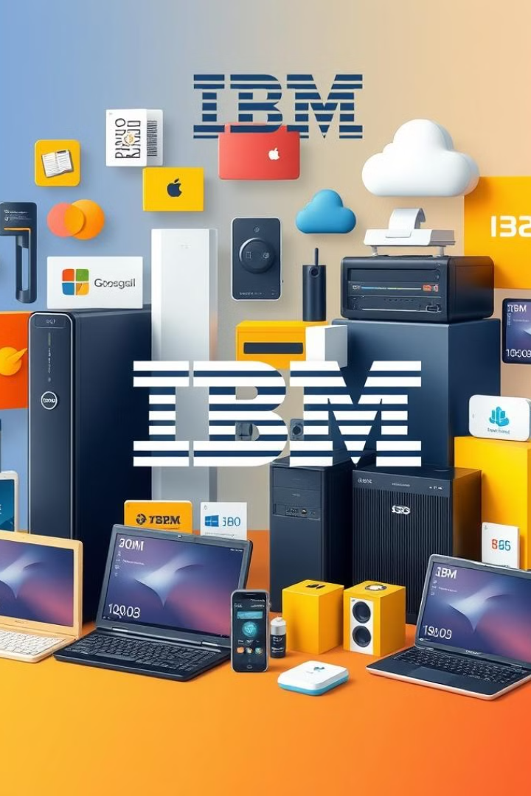




Innovative Products and Services
Cloud Computing
Artificial Intelligence
IBM's advanced cloud solutions empower businesses to scale their operations, optimize their infrastructure, and unlock new opportunities for innovation.
IBM's AI and machine learning capabilities enable organizations to make data-driven decisions, automate processes, and gain deeper insights into their operations.
Quantum Computing
Blockchain
As a pioneer in quantum technology, IBM is at the forefront of developing revolutionary computing solutions that will unlock unprecedented computational power.
IBM's blockchain platforms help businesses enhance security, transparency, and efficiency in their transactions and supply chain operations.

Slide 7





Global Reach and Impact
Worldwide Presence
Transformative Solutions
Social Responsibility
With operations in over 175 countries, IBM has a truly global footprint, serving clients and partners across diverse industries and geographies.
IBM's innovative technologies and services have a far-reaching impact, helping organizations and communities around the world unlock new opportunities for growth and progress.
Guided by its core values, IBM is committed to using its technological expertise to address global challenges and drive positive change in the world.

Slide 8


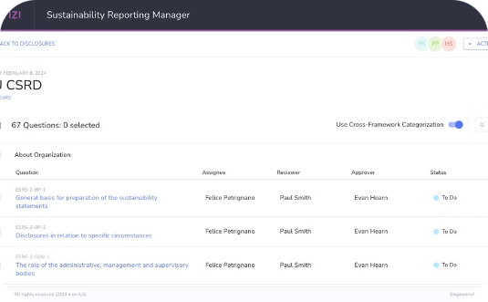
Commitment to Sustainability
Renewable Energy
Circular Economy
Sustainable Operations
IBM is actively transitioning to renewable energy sources, with a goal of sourcing 55% of its electricity needs from renewable sources by 2025.
IBM is committed to implementing circular economy principles, focusing on reusing, refurbishing, and recycling its products and materials to minimize waste and environmental impact.
IBM's comprehensive sustainability strategy encompasses energy efficiency, water conservation, and waste reduction across its global operations, driving progress towards a more sustainable future.

Slide 9

Leadership in Technology
Research & Development
IBM invests heavily in research and development, with a global network of research labs dedicated to advancing the frontiers of technology and addressing complex challenges.
Patents
IBM holds an industry-leading portfolio of patents, reflecting its consistent innovation and technological breakthroughs across a wide range of domains.
Industry Recognition
IBM's pioneering work has earned it numerous accolades and industry awards, solidifying its reputation as a global leader in technology and innovation.

Slide 10


Conclusion and Call to Action
As a technology pioneer with a rich history and a bold vision, IBM is poised to continue shaping the future of business and society. Through its unwavering commitment to innovation, its global reach, and its dedication to sustainable progress, IBM invites you to join its mission and be a part of the transformative journey ahead.

